Slide 1


Whole genome approaches
Gibran Hemani
g.hemani@bristol.ac.uk
Epigenetic Epidemiology Short course 2018

Slide 2
Outline
The missing heritability
GCTA and the limits of GWAS
LD score regression
Genetic correlations

Slide 3
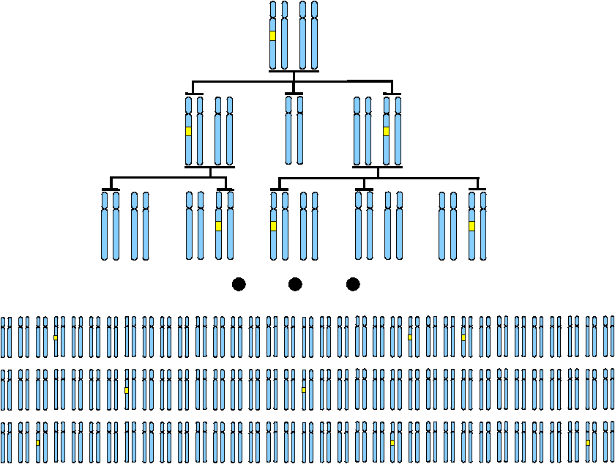
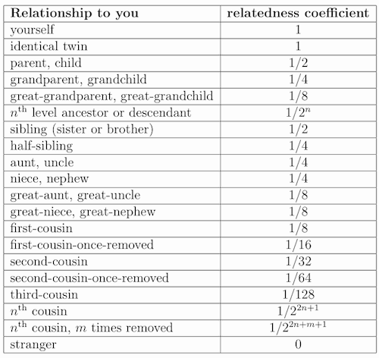
Family-based heritability
Segment of DNA shared by two or more people that has been inherited from a recent common ancestor without any intervening recombination
Relatedness (or kinship) coefficients
Notes:
Segments of DNA are passed on and we can define total genomic sharing as the proportion of total DNA that two individuals share that is identical by descent.
The expected values are shown in the table.
Notice – it’s kind of arbitrary where we decide to stop and end up just giving a value of 0

Slide 4
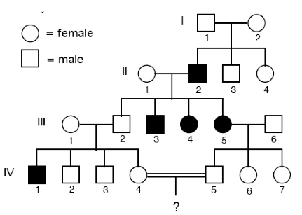
Using related individuals to estimate heritability
Tabulating data from the family tree
Relationship | Genetic similarity | ID1 phenotype | ID2 phenotype | (Phenotypic difference)²
Parent-offspring | 0.5 | 20 | 22 | 4
Siblings | 0.5 | 21 | 23 | 4
Grandparent-grandchild | 0.25 | 22 | 26 | 16
First cousins | 0.125 | 29 | 24 | 25
MZ Twins | 1.0 | 24 | 25 | 1
Unrelated | 0 | 30 | 20 | 100

Slide 5
Haseman-Elston regression
Plot genetic similarity against phenotypic difference for all pairs of individuals
The slope is -2h²

Slide 6
Quick recap
GWAS does this:
What is the relationship between the number of risk alleles and the risk of disease?
Heritability asks this:
If people are more genetically similar, are they also more phenotypically similar?

Slide 7
Heritability
The proportion of the variance in the phenotype in a population that is due to genetic factors
h² = V_{A} / V_{P}

Slide 9
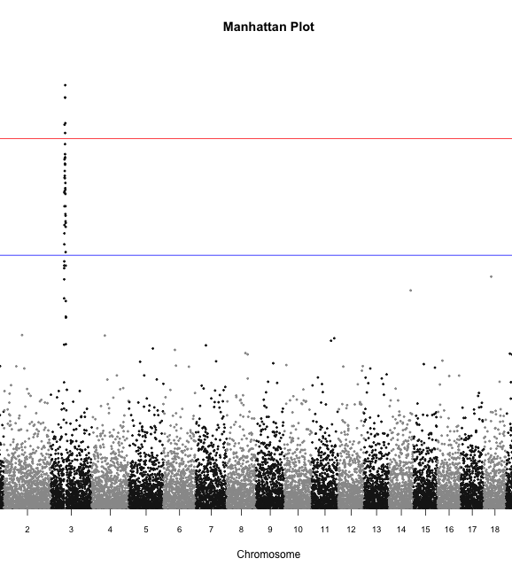
Where is GWAS going?
How much variance does our significant SNP explain?
V_{A}/V_{P} = 2a²p(1-p)/V_{P}
Usually very small
Much less than the total heritability predicted to exist from pedigree and twin studies
AKA the missing heritability problem

Slide 10
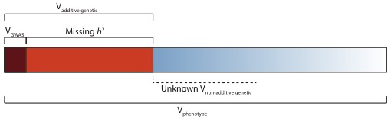
Missing heritability

Slide 11
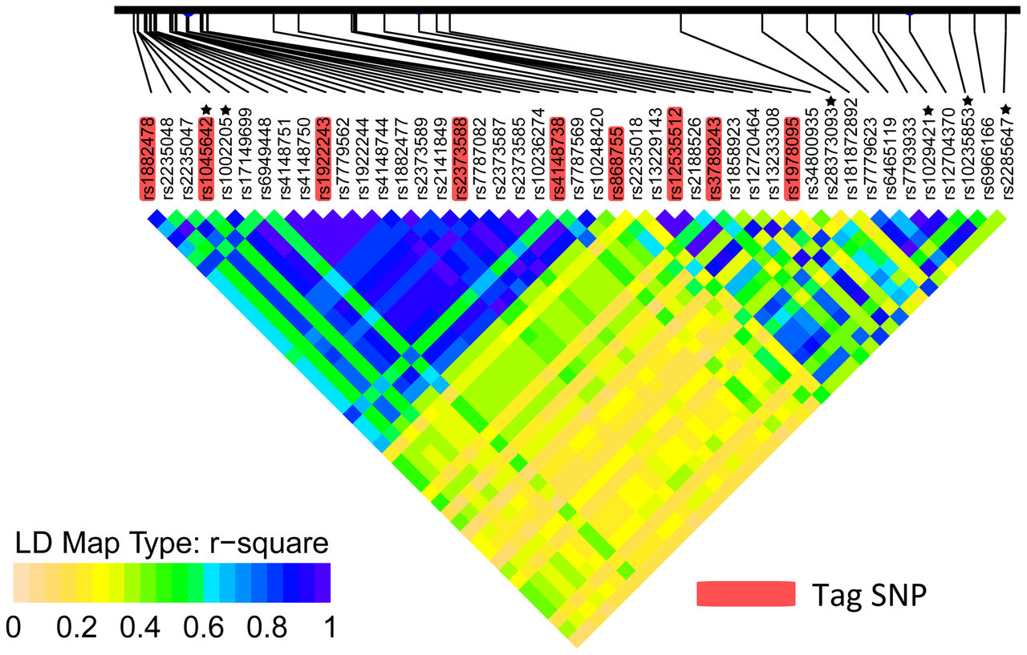
Where is GWAS going?
SNP chips use common tagging SNPs
Question: How much of total heritability have we managed to capture using this technology?
Around 12 million common variants
SNP chips usually have fewer than 1 million
Estimated to capture at least 80% of genetic variation
Countless millions of rare variants
SNP chips capture very tiny proportion of rare variation in unrelated individuals

Slide 12
Can we estimate how much of the phenotypic variance could be explained by all the measured SNPs on our SNP chips?

Slide 13
Ideally would do something like this…
Y = α
+ β₁ X₁ + β₂ X₂ + β₃ X₃ + β₄ X₄ + β₅ X₅ + β₆ X₆ + β₇ X₇ + β₈ X₈
+ β₉ X₉ + β₁₀X₁₀ + β₁₁X₁₁ + β₁₂X₁₂ + β₁₃X₁₃ + β₁₄X₁₄ + β₁₅X₁₅ + β₁₆X₁₆
+ β₁₇X₁₇ + β₁₈X₁₈ + β₁₉X₁₉ + β₂₀X₂₀ + β₂₁X₂₁ + β₂₂X₂₂ + β₂₃X₂₃ + β₂₄X₂₄
+ .... + .... + .... + .... + .... + .... + .... + ....
+ β_{500,000}X_{500,000}
+ e
Akin to fitting all SNPs in a linear model where every SNP is assumed to have an effect
Unfortunately not possible – more parameters than samples

Slide 14
Question
What would the genetic prediction accuracy from GWAS be if we had an infinite sample size?
Or in other words – what is the limit of SNP chip technology?
Or in other words – how much of the variance can be captured by all measured SNPs?
Which leads to – at what point might we have to abandon SNP chips and use sequencing?

Slide 15
Alternative to HE reg, mixed model approach
Kinship matrix
1 0.5 0.13 0.0 0.06 0.0
0.5 1 0.13 0.0 0.13 0.0
0.13 0.13 1 0.0 0.0 0.06
0.0 0.0 0.0 1 0.25 1
0.06 0.13 0.0 0.25 1 0.38
0.0 0.0 0.06 1 0.38 1
1
1
1
-1
-1
-1
1 1 1 -1 -1 -1
1 1 1 -1 -1 -1
1 1 1 -1 -1 -1
-1 -1 -1 1 1 1
-1 -1 -1 1 1 1
-1 -1 -1 1 1 1
σ_{g}²
σ_{e}²
Phenotype Y
Phen covariance YY^{T}
1 0 0 0 0 0
0 1 0 0 0 0
0 0 1 0 0 0
0 0 0 1 0 0
0 0 0 0 1 0
0 0 0 0 0 1
Use REML to divide phenotypic variance into:
σ_{g}² = Genetic covariance matrix
σ_{e}² = Residual error
Then we can estimate h² = σ_{g}² / (σ_{g}² + σ_{e}²)
Notes:
Trying to explain as much phenotypic covariance as possible using the genetic covariance

Slide 16
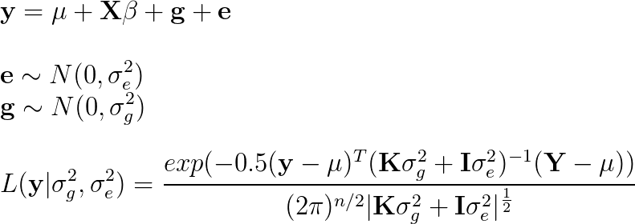
Mixed model approach - more statistically powerful than HE regression
Partition variance into covariates,
genetic effects and residuals
Use REML to maximise likelihood for estimation of σ_{g}² and σ_{e}² parameters
Notes:
Mention common environmental variance

Slide 17
How does this help us estimate the proportion of the variance captured by the SNPs? Use SNP data to estimate the kinships between unrelated individuals

Slide 18
Estimating the realised genomic similarity using SNPs: Identity by state (IBS)
Objective: For each pair of individuals see how many alleles they have in common as a proportion of all alleles – this is our measure of genetic similarity
Step 1: Take all your SNPs and normalise them so that they have mean 0 and variance 1
Step 2: For each pair of individuals increase their score when they have the same genotype at a SNP, decrease it when they have a different genotype

Slide 19
Estimating the realised genomic similarity using SNPs
Raw genetic data, S matrix
Scale each SNP to have mean 0, variance 1, Z matrix
ID | SNP1 | SNP2 | SNP3
1 | 0 | 2 | 0
2 | 1 | 1 | 2
3 | 0 | 0 | 0
4 | 0 | 2 | 1
5 | 1 | 2 | 2
6 | 0 | 1 | 1
7 | 2 | 0 | 0
ID | SNP1 | SNP2 | SNP3
1 | -0.7 | 2.1 | -1.0
2 | 0.5 | -0.5 | 1.3
3 | -0.7 | -0.4 | -1.0
4 | -0.7 | 2.1 | 0.2
5 | 0.5 | 2.1 | 1.3
6 | -0.7 | -0.5 | 0.2
7 | 1.8 | -0.4 | -1.0
Notes:
Step 1: Why normalise?
Imagine a SNP with low MAF – lots of people with 0 genotype, more likely to have high sharing by chance: low variance = low contribution to genomic sharing
Compare to a SNP with intermediate MAF – more likely to be lower sharing because more possible combinations: high variance = high contribution to genomic sharing
By normalising we are making equal contribution for all SNPs

Slide 20
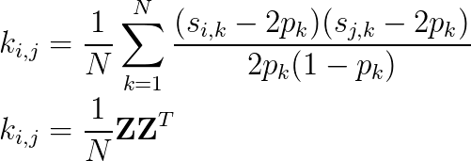
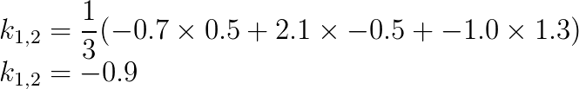
Estimating the realised genomic similarity using SNPs
Z matrix:
Calculating genetic relationship matrix
(or kinship matrix):
ID | SNP1 | SNP2 | SNP3
1 | -0.7 | 2.1 | -1.0
2 | 0.5 | -0.5 | 1.3
3 | -0.7 | -0.4 | -1.0
4 | -0.7 | 2.1 | 0.2
5 | 0.5 | 2.1 | 1.3
6 | -0.7 | -0.5 | 0.2
7 | 1.8 | -0.4 | -1.0
Example:
This creates a NxN symmetrical genetic relationship matrix (GRM).
This can be used as a kinship matrix in the mixed model approach. – Genomic REML
Notes:
This is a big operation. It is making an n x n matrix, and for each cell in that matrix they had to do N sums

Slide 21
Mixed model approach (unrelateds)
Kinship matrix
1 0.5 0.13 0.01 0.09 0.01
0.5 1 0.13 0.02 0.07 0.04
0.13 0.13 1 0.03 0.01 0.05
0.01 0.02 0.03 1 0.25 1
0.09 0.07 0.01 0.25 1 0.38
0.01 0.04 0.05 1 0.38 1
1
1
1
-1
-1
-1
1 1 1 -1 -1 -1
1 1 1 -1 -1 -1
1 1 1 -1 -1 -1
-1 -1 -1 1 1 1
-1 -1 -1 1 1 1
-1 -1 -1 1 1 1
σ_{g}²
σ_{e}²
Phenotype Y
Phen covariance YY^{T}
1 0 0 0 0 0
0 1 0 0 0 0
0 0 1 0 0 0
0 0 0 1 0 0
0 0 0 0 1 0
0 0 0 0 0 1
Use REML to divide phenotypic variance into:
σ_{g}² = Genetic covariance matrix
σ_{e}² = Residual error
Then we can estimate h² = σ_{g}² / (σ_{g}² + σ_{e}²)
Notes:
Trying to explain as much phenotypic covariance as possible using the genetic covariance

Slide 22
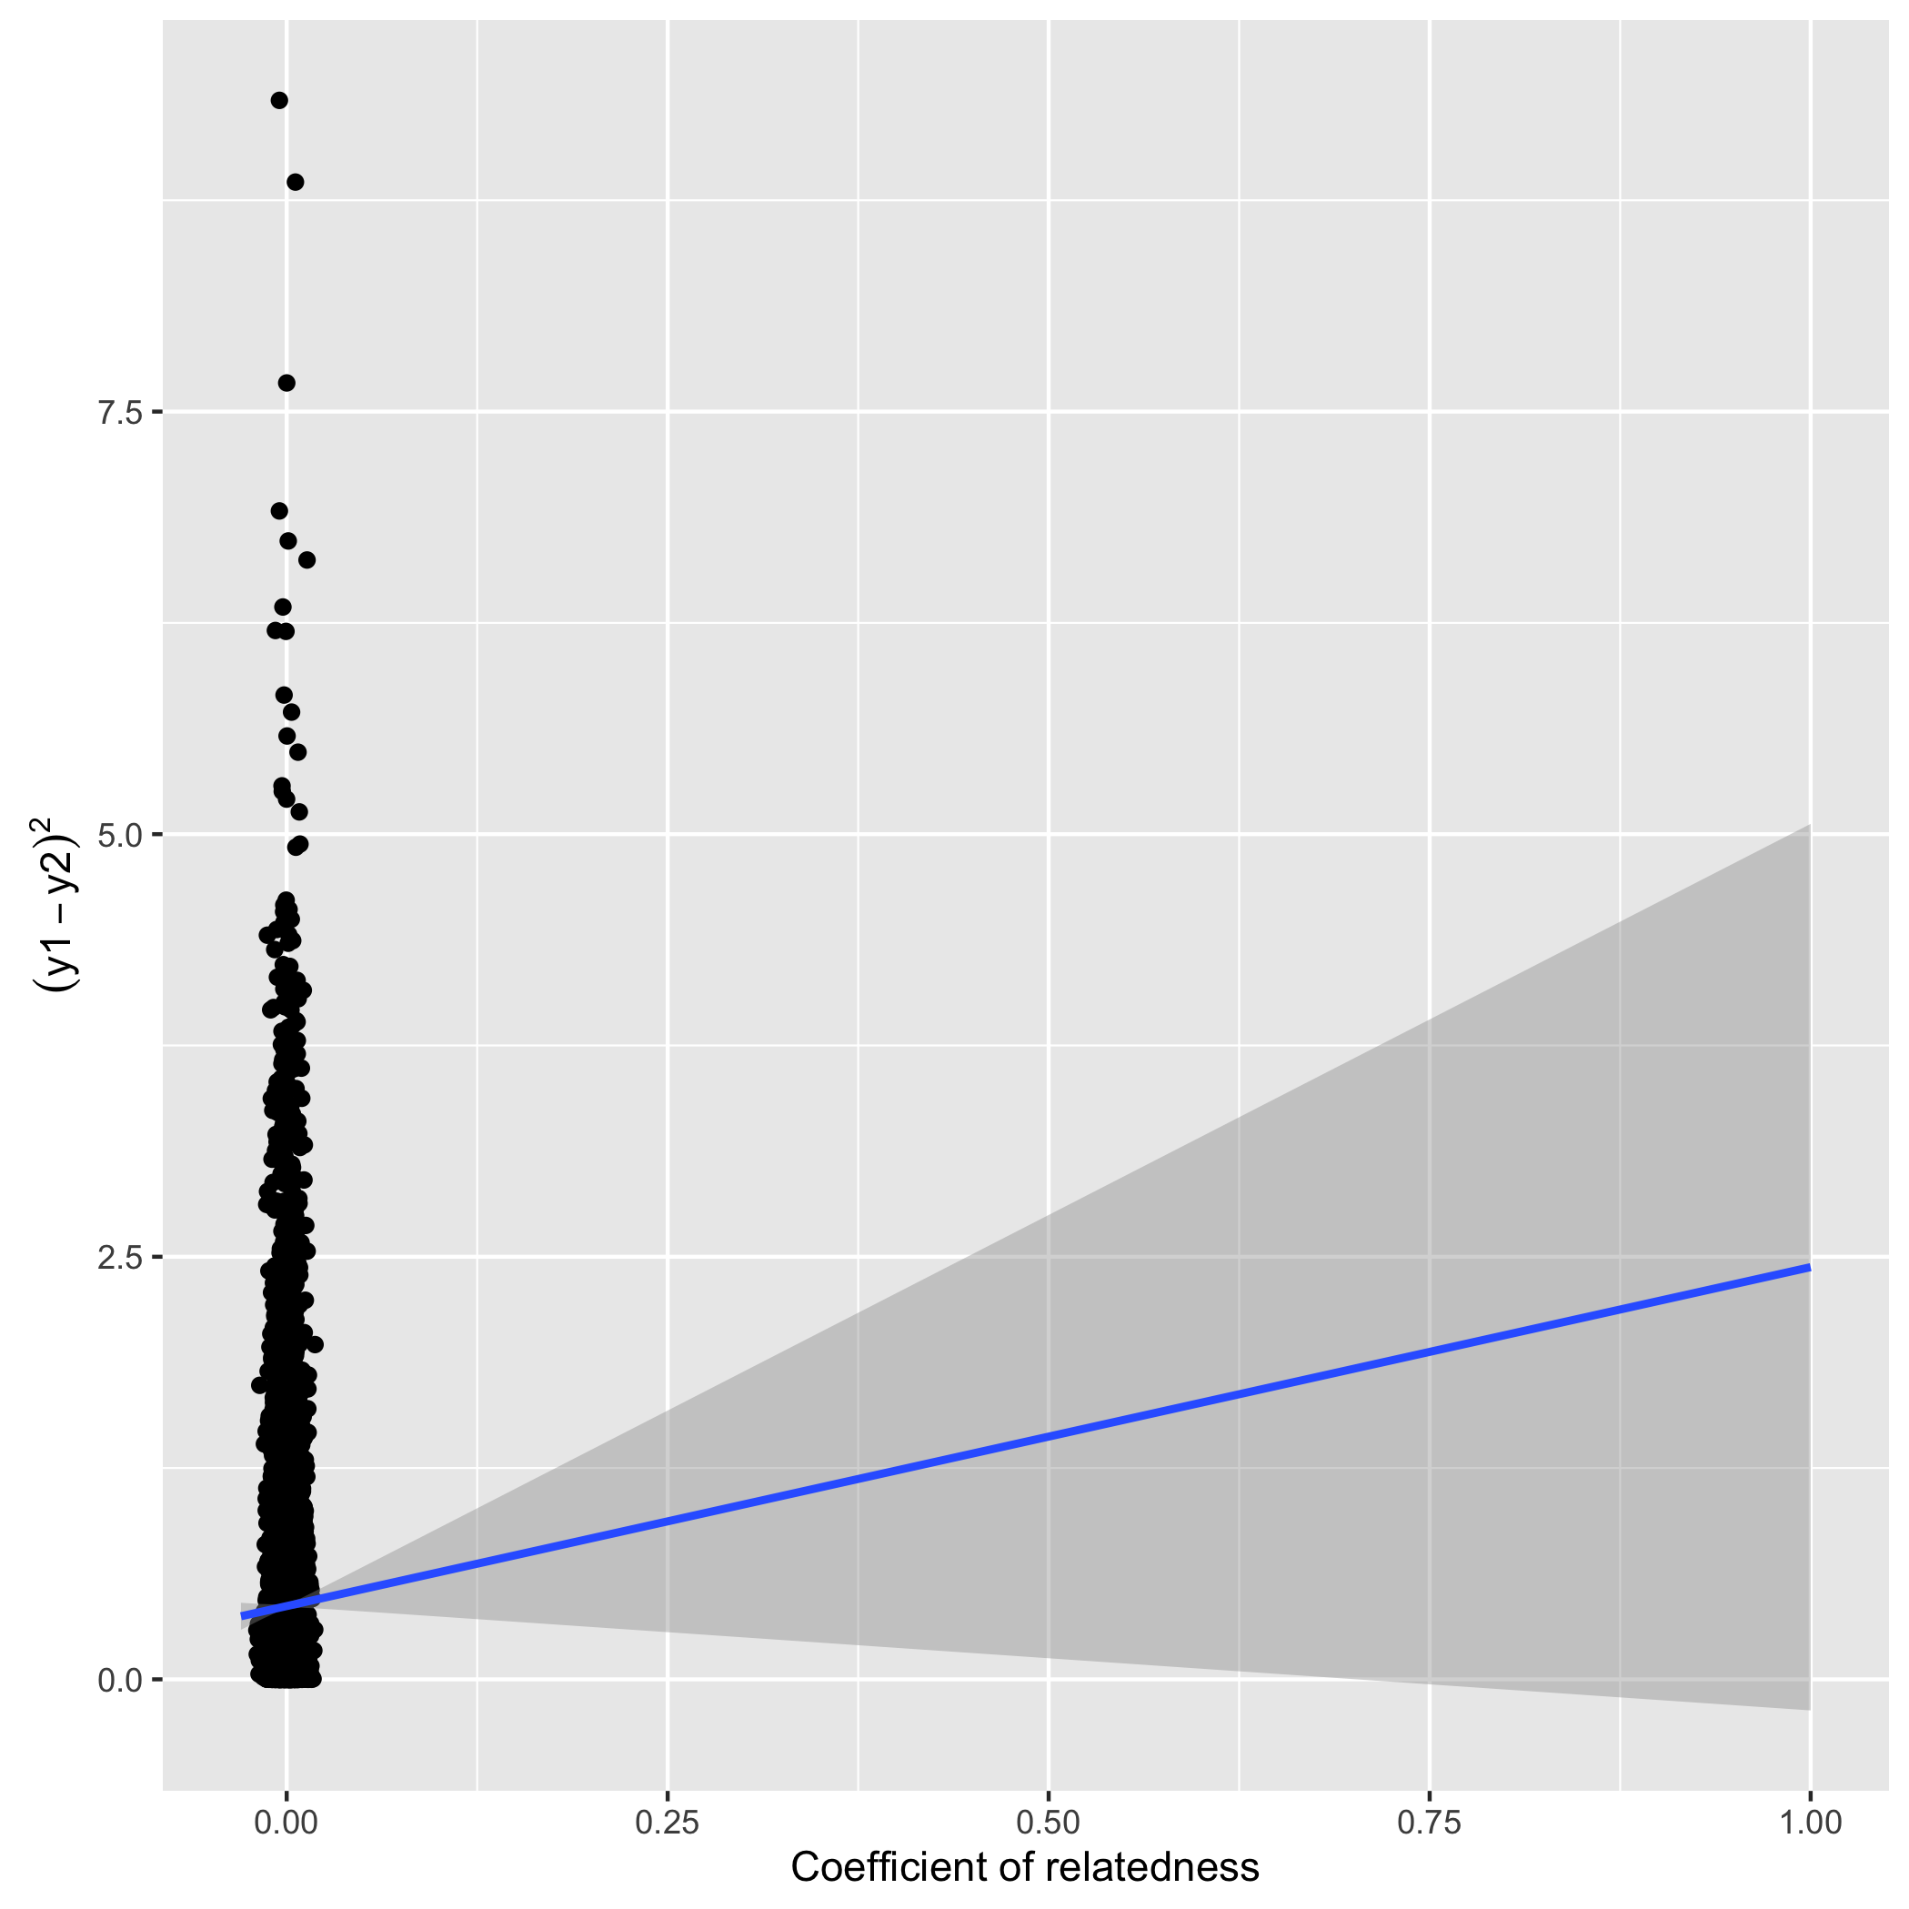
Precision of heritability estimates goes down when using unrelated samples
Using family data
Using unrelateds
Amongst unrelateds all kinships are close to 0, very low variance, which reduces power
Notes:
Higher precision with closer relationships
Higher precision when using actual amount of genetic sharing compared to expected amount
Higher precision when pedigree is more complete

Slide 23
How will “SNP heritability” compare to real heritability?

Slide 24
How will “SNP heritability” compare to real heritability?
If ALL the causal variants are not in LD with our observed SNPs then SNP heritability should be lower than real heritability

Slide 25
When individuals are unrelated…
Slide courtesy of Doug Speed
SNP heritability = proportion of phenotypic variance explained by all measured SNPs
But what if the causal variants are not in LD with the tag SNPs?
Notes:
Smaller segments of IBD
If the causal variant is far from the closest tag SNP then its variance will not be captured

Slide 26
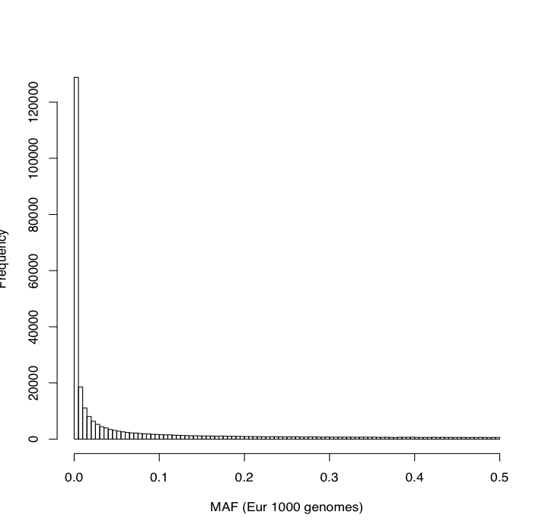
Distribution of allele frequencies
SNP chip
Sequence data

Slide 27
How important are rare variants?
Common SNPs fail to tag rare variants
But a single rare variant unlikely to explain much variation
Allele frequency
Effect size
p(1-p) is small when p is small

Slide 28
Estimates of h2 and SNP h2
Typically SNP h² is about 50% of ‘true’ h²
This tells us that the capacity of SNP chips used in general populations to map all genetic effects is good, but limited

Slide 29
Interpreting SNP heritability
Suppose trait A and trait B both have h² = 0.8 estimated from twin studies. We use unrelated individuals to estimate SNP h² for each trait in the same population
Trait A has SNP h² = 0.4
Trait B has SNP h² = 0.2
How can we interpret this result?
Notes:
Either SNP chips are capturing less of the causal variants in trait B (e.g. rare variants, under selection)
Or there was some confounding in the twin study heritability estimate for trait B

Slide 30
Latest version of GCTA
Uses imputed data
Capturing almost all common genetic variation
Not capturing very large proportion of rare variation
Finds ‘negligible’ missing heritability
i.e. for height and BMI almost all the heritability can be explained by common variants
This approach requires very large imputed sample sizes e.g. 35k+

Slide 31
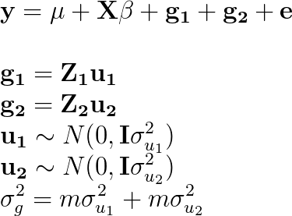
Genomic partitioning
Y = α
+ β₁ X₁ + β₂ X₂ + β₃ X₃ + β₄ X₄ + β₅ X₅ + β₆ X₆ + β₇ X₇ + β₈ X₈
+ β₉ X₉ + β₁₀X₁₀ + β₁₁X₁₁ + β₁₂X₁₂ + β₁₃X₁₃ + β₁₄X₁₄ + β₁₅X₁₅ + β₁₆X₁₆
+ β₁₇X₁₇ + β₁₈X₁₈ + β₁₉X₁₉ + β₂₀X₂₀ + β₂₁X₂₁ + β₂₂X₂₂ + β₂₃X₂₃ + β₂₄X₂₄
+ e
Create multiple GRMs, and estimate the variance attributable to each GRM
Examples:
A partition for each chromosome
Two partitions to compare genic vs non-genic SNPs
Divide SNPs into different MAF categories

Slide 32
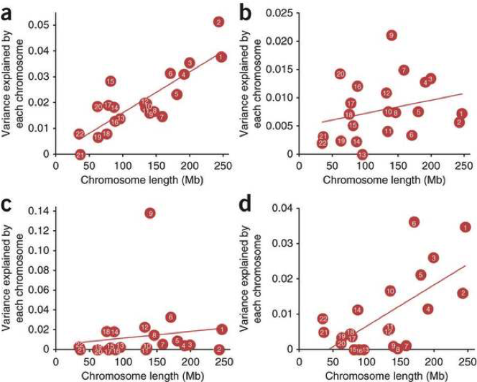
Genome partitioning: polygenic model
Height
BMI
vWF
QTi
Yang et al 2012
Notes:
Shows that larger chromosomes explain more variance: consistent with infinitesimal model.
Also note that sometimes there is a huge effect somewhere, e.g. chr 9 for vWF or chr 6 for Qti

Slide 33
Linear mixed models for GWAS
One way to control for population structure is to perform a GWAS where for each SNP you estimate its effect while adjusting for all other SNPs
There now exist many fast implementations for this
FaSTLMM
GenABEL
GEMMA
EMMAX
GCTA
BoltLMM (fastest)

Slide 34
LD score regression

Slide 35
As GWAS uses larger sample sizes…
More power to detect small biological effects
But also more power to detect effects of subtle population stratification
Q-Q plot from schizophrenia GWAS – biological or technical inflation?

Slide 36
Population stratification induces LD
Two populations (A and B) diverged from a common ancestor
Allele frequencies are systematically different between those two populations
Combining populations A and B will induce correlations between SNPs across the genome

Slide 37
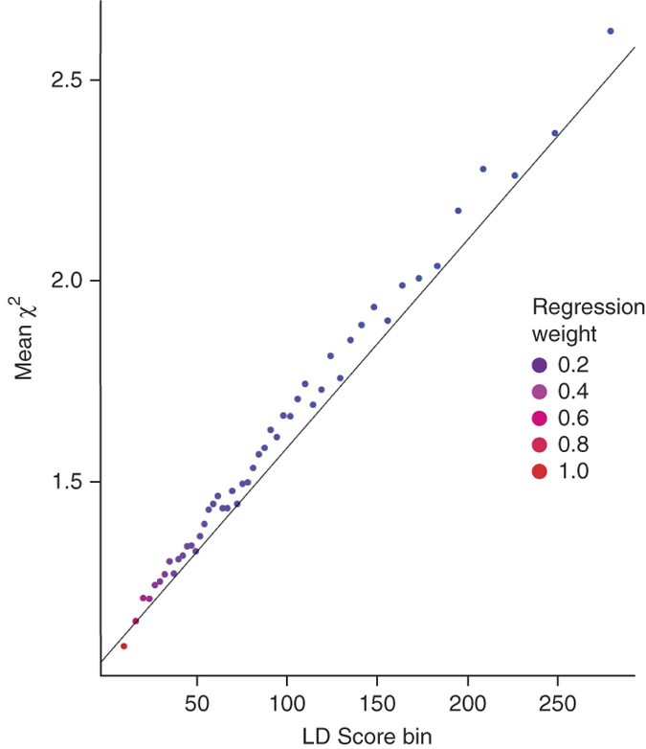
Consequences of population stratification in LD score regression
Allele frequencies predict population structure
Differences in disease prevalence between populations
Every SNP will be slightly associated with the disease
Finally, every pair of SNPs has slightly elevated LD
The intercept of LD score regression will increase, with the slope staying the same
LD score regression separates biological genetic effects from technical affects due to population stratification

Slide 38
LD score regression
Imagine every SNP has a random effect
In GWAS, a SNP with high LD would have larger effects because they would be the combined influence of their own effect and those that are correlated with them

Slide 39
LD score regression
Plot ‘LD score’ (average R²) vs GWAS test statistic
Slope = SNP heritability
Heritability can be estimated using just GWAS summary statistics
But another utility also…

Slide 40
Alternatively…
We can also learn about heritability based on how well we can predict a trait using polygenic risk scores

Slide 41
AVENGEME
Create an allele score based on GWAS results
Calculate the prediction accuracy of the allele score in an independent sample
SNP h2 can be inferred depending on:
Training sample size
Testing sample size
Correlation between PRS and test trait
Threshold used to calculate PRS

Slide 42
 | GREML | LD Score regression | AVENGEME
Data required | Individual level genetic and phenotypic data | GWAS summary statistics | GWAS summary statistics with replication
Statistical efficiency | High | Low | High
Bivariate analysis | Yes | Yes | Yes
Confounding estimation | No | Yes | No
Estimates of number of causal variants | No | No | Yes
Software available | Yes – GCTA and LDAK | Python scripts and also online platform (LD Hub) | Kind of. R scripts to do calculations but you need to do a few steps first
Reliability of inferences | Biases exist and are somewhat understood | Largely unexplored so far | Largely unexplored so far

Slide 43
Genetic correlations
To what extent do two traits share the same genetic factors?

Slide 44
Genetic correlations – bivariate analysis
Y₁ = α₁ + β₁ X₁ + β₂ X₂ + β₃ X₃ + β₄ X₄ + β₅ X₅ + β₆ X₆ + ... + e₁
Y₂ = α₂ + λ₁ X₁ + λ ₂ X₂ + λ ₃ X₃ + λ ₄ X₄ + λ ₅ X₅ + λ ₆ X₆ + ... + e₂
Question: To what extent are the SNPs that influence trait 1 the same that influence trait 2 in terms of concordance of magnitude and direction of effect sizes?
cor(β, λ) = r_{g}, where values can range from -1 to 1.
Use generalised REML implementation which analyses two traits jointly, estimating σ²_{g1} and σ²_{g2} and also r_{g}.
Interpretation:
Proportion of h² that can be explained in trait 1 if perfect knowledge of all SNPs influencing trait 2. And vice versa
Is there pleiotropy between two traits?
Better understand relationship between sub phenotypes

Slide 45
Bivariate LD score regression
LD score regression can be adapted to estimate the extent to which the joint effects of each SNP from two GWASs are related to the LD score

Slide 46
Using LD score regression to estimate genetic correlation
Notes:
Note this is very powerful – doing this with individual level data would be extremely challenging

Slide 47
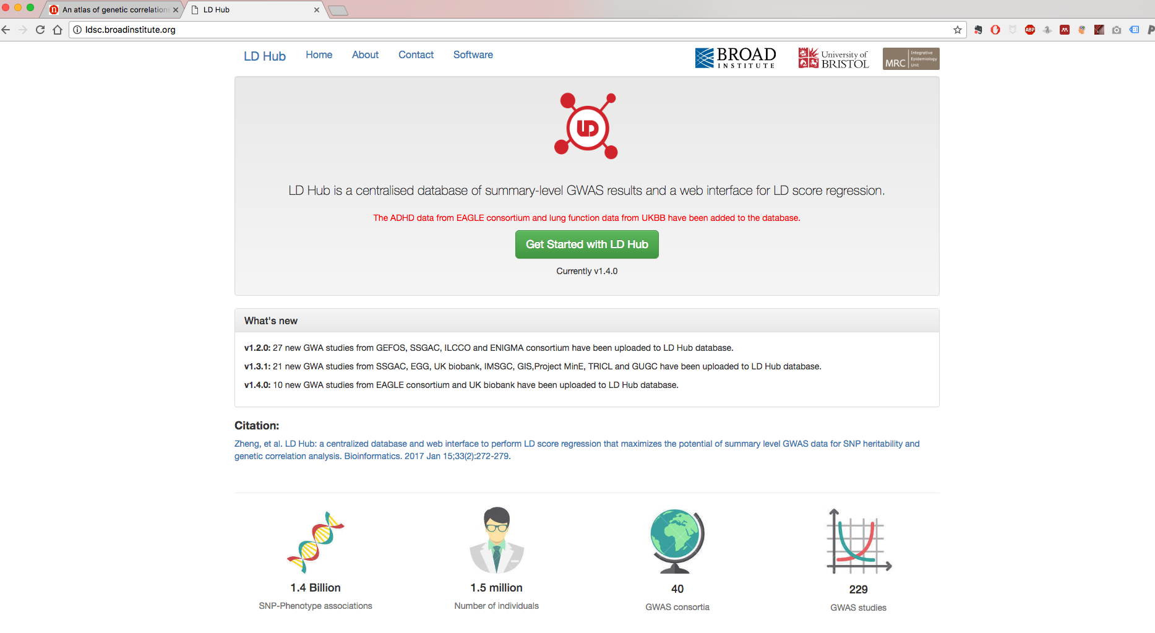
LD Hub – automated LD score regression + genetic correlations with hundreds of traits!

Slide 48
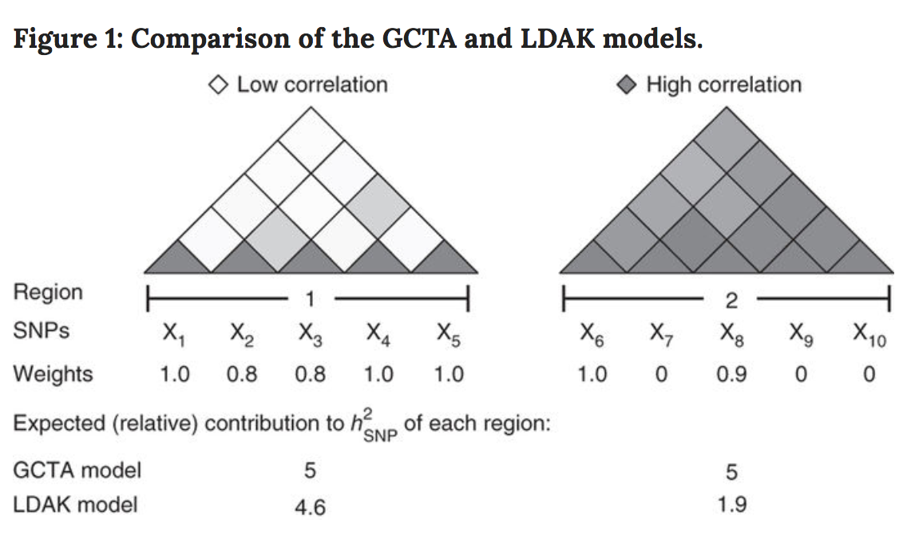
Controversy and assumptions

Slide 49
Summary
Genetic variants that do not reach genome-wide significance can still be exploited
Evidence that complex traits are influenced by very large number of common SNPs
The missing heritability will be largely solved by performing larger GWASs
GWAS summary data can be highly informative, especially for understanding how different traits relate to each other

Slide 50
References
Useful reviews:
Introduction to Quantitative Genetics. Falconer D.S., Mackay T.F.C. Longman; Harlow, UK: 1996.
Heritability in the genomics era—concepts and misconceptions. Visscher P.M., Hill W.G., Wray N.R. Nat. Rev. Genet. 2008;9:255–266
Relatedness in the post-genomic era: is it still useful? Doug Speed & David J. Balding. Nature Reviews Genetics 16, 33–44 (2015)
The heritability of human disease: estimation, uses and abuses. Tenesa A1, Haley CS. Nat Rev Genet. 2013 Feb;14(2):139-49.
Reconciling the analysis of IBD and IBS in complex trait studies. Powell J.E., Visscher P.M., Goddard M.E. Nat. Rev. Genet. 2010;11:800–805
Finding the missing heritability of complex diseases. Manolio T.A., Collins F.S., Cox N.J., Goldstein D.B., Hindorff L.A., Hunter D.J., McCarthy M.I., Ramos E.M., Cardon L.R., Chakravarti A. Nature. 2009;461:747–753.
Heritability of threshold characters. Dempster E.R., Lerner I.M. Genetics. 1950;35:212–236.
Primary research papers:
Inference of the genetic architecture underlying BMI and height with the use of 20,240 sibling pairs. Hemani G et al. Am J Hum Genet. 2013 Nov 7;93(5):865-75.
Common SNPs explain a large proportion of the heritability for human height. Yang J., Benyamin B., McEvoy B.P., Gordon S., Henders A.K., Nyholt D.R., Madden P.A., Heath A.C., Martin N.G., Montgomery G.W. Nat. Genet. 2010;42:565–569
Genome-partitioning of genetic variation for complex traits using common SNPs. Yang J, Manolio TA, Pasquale LR, et al. Nature genetics. 2011;43(6):519-525. doi:10.1038/ng.823.
Improved heritability estimation from genome-wide SNPs. Speed D, Hemani G, Johnson MR, Balding DJ. Am J Hum Genet. 2012 Dec 7;91(6):1011-21.
Estimating Missing Heritability for Disease from Genome-wide Association Studies. Lee SH, Wray NR, Goddard ME, Visscher PM. American Journal of Human Genetics. 2011;88(3):294-305. doi:10.1016/j.ajhg.2011.02.002.
Estimation of pleiotropy between complex diseases using single-nucleotide polymorphism-derived genomic relationships and restricted maximum likelihood. Lee SH, Yang J, Goddard ME, Visscher PM, Wray NR. Bioinformatics. 2012;28(19):2540-2542. doi:10.1093/bioinformatics/bts474.
LD Score regression distinguishes confounding from polygenicity in genome-wide association studies. Bulik-Sullivan et al. Nature Genetics. 2015
A Fast Method that Uses Polygenic Scores to Estimate the Variance Explained by Genome-wide Marker Panels and the Proportion of Variants Affecting a Trait. Luigi Palla and Frank Dudbridge. AJHG. 2015

